Slide 1
More Fancy Figures (stored on a server)
Wigge’s Lab meeting
2018.12.3
Feng Geng

Slide 2
Save the links!
Address:
http://172.26.114.34:81/ (haven’t setup a home page yet)
Meta data server:
Username: teamPAW
Password: passwordPAW
http://172.26.114.34:81/admin/metaio/
Template filling:
http://172.26.114.34:81/admin/metaio/tag/softTemplate-Sample-RNASeq-Martin/change/
Figure repository:
http://172.26.114.34:81/static/figures/

Slide 3
Once upon a time….

Slide 4
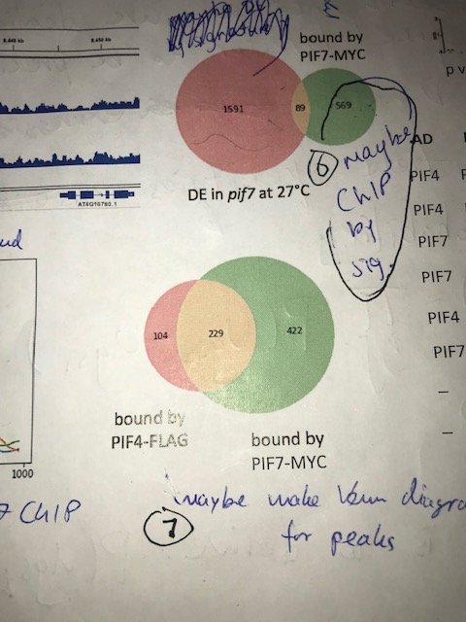
Once upon a time...
Numbers were supposedly produced by me sometime in the history.
Problem: needs to document the cutoff and the ChIP used to derive the numbers.
Martin

Slide 5
Once upon a time...
Numbers were supposedly produced by me sometime in the history.
Problem: needs to document the cutoff and the ChIP used to derive the numbers.
Just go to the link!
http://172.26.114.34:81/static/figures/1126__PIF7-PIF4__overlap-peaklevel/figure.html
No more need to embed images in the EN as long as you can access SLCU intranet.
Martin

Slide 6
Once upon a time...
Numbers were supposedly produced by me sometime in the history.
Problem: needs to document the cutoff and the ChIP used to derive the numbers.
Just go to the link!
http://172.26.114.34:81/static/figures/1126__PIF7-PIF4__overlap-peaklevel/figure.html
No more need to embed images in the EN as long as you can access SLCU intranet.
Martin

Slide 7
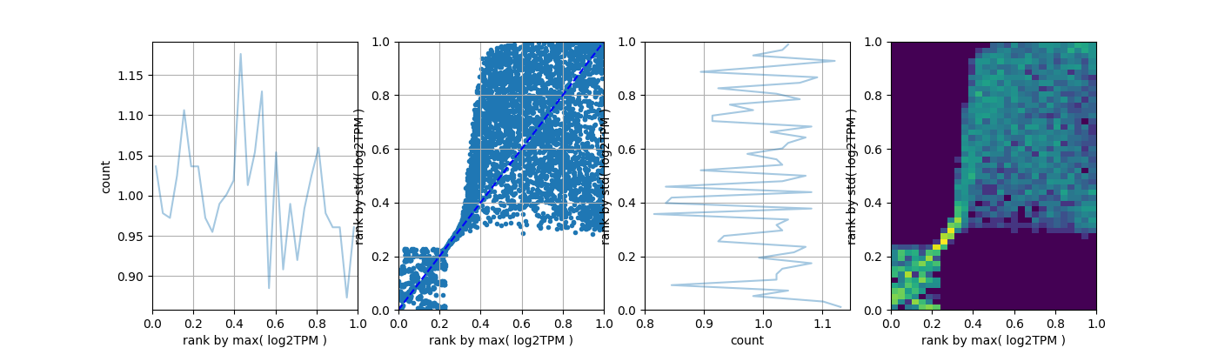
Brief update of a quality control measure on RNA-Seq
http://172.26.114.34:81/static/figures/1129__RNAPREP__196R/figure.html
http://172.26.114.34:81/static/figures/1126__PIF7__tempResp-AND-pif7Resp/figure.html

Slide 8
We have done some ChIP-Seqs:
1505-17C-ZT0_S15
1505-17C-ZT16_S16
1505-27C-ZT0_S17
1505-27C-ZT16_S18
1505-ZT12-17C_S11
1505-Zt12-27C_S12
1505-ZT0-17C_S13
PIF7-PIF7-MYC-LD-27C-ZT8_S10
PIF7-PIF7-MYC-LD-17C-ZT12_S11
PIF7-PIF7-MYC-LD-27C-ZT12_S12
PIF7-PIF7-MYC-LD-17C-ZT8_S9
And also some RNA-Seqs
Will:
1. Assess ChIPSeq models after fixing RNA-Seq targets
2. Assess RNASeq models after fixing ChIP-Seq targets

Slide 9
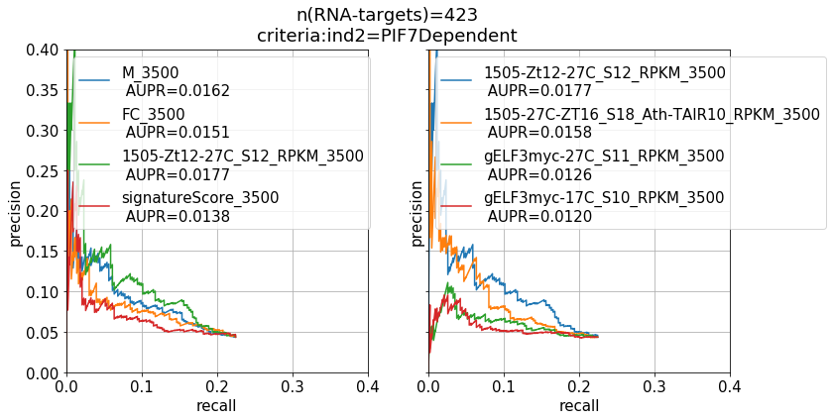
chipseq2rnaseq: Fixing the RNA-Seq targets according to a criteria
Fold change does not predict RNAseq response as well as average binding.

Slide 10
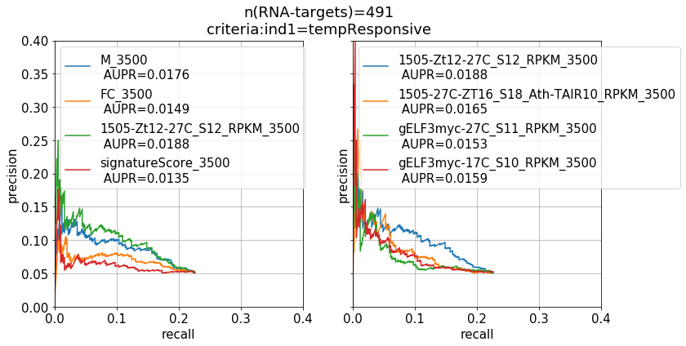
chipseq2rnaseq: Fixing the RNA-Seq targets according to a criteria
Fold change does not predict RNAseq response as well as average binding.

Slide 11
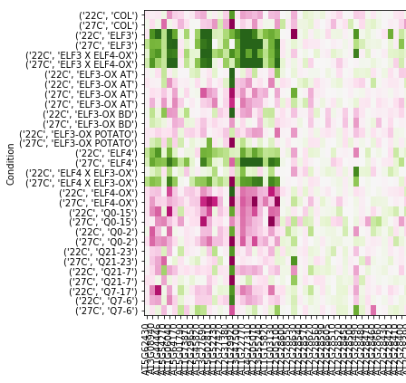
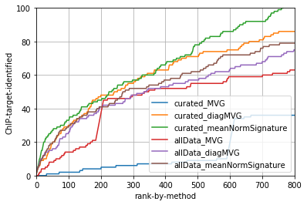
rnaseq2chipseq:
Fixing the ChIP-Seq targets according to a criteria.
Extrapolated from marker targets
Marker targets
allData: ZT8 ZT12
Curated:ZT12-only

Slide 12
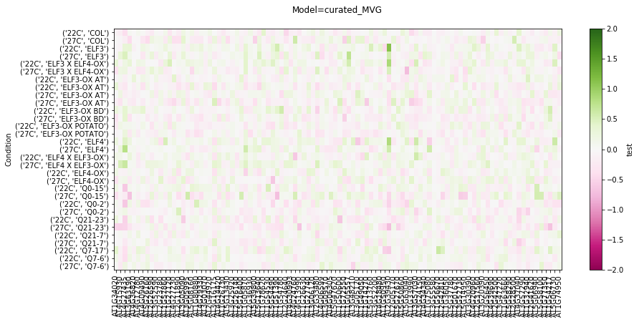
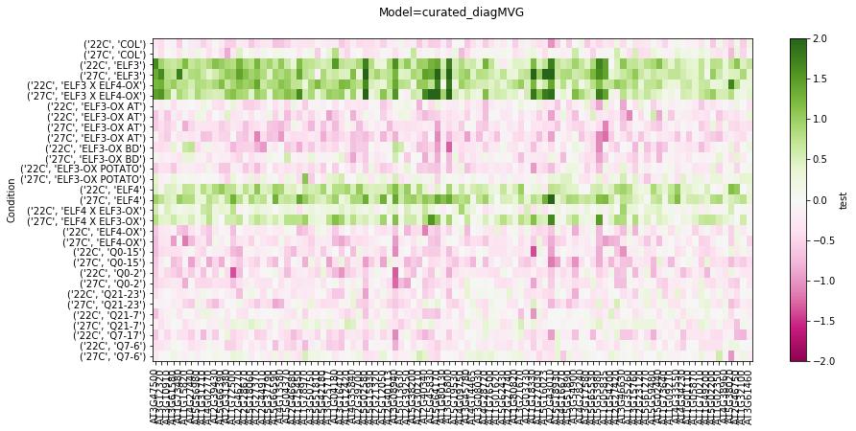
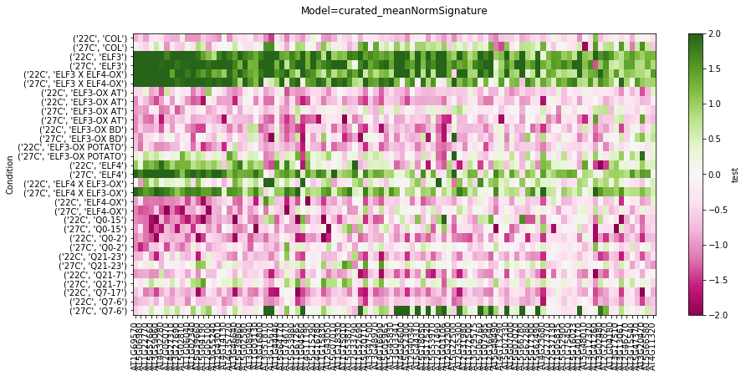
Fixing the ChIP-Seq targets according to a criteria.
Extrapolated from marker targets
allData: ZT8 ZT12
Curated:ZT12-only

Slide 13
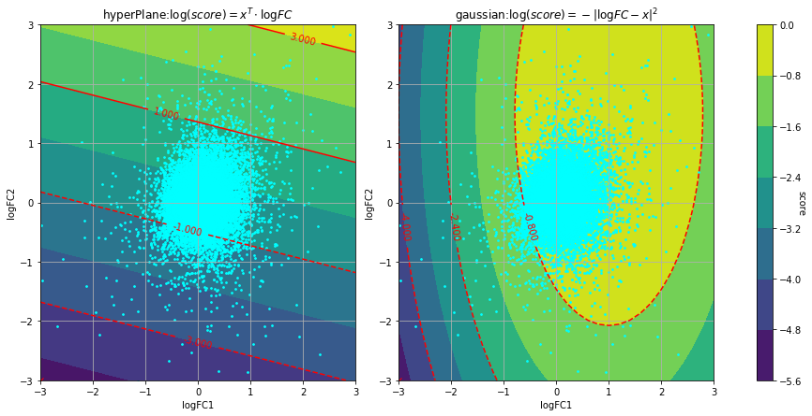
MeanNormSignature leads to a statistical model based on hyperplane instead of ellipses ( on which Normal distributions are based).

Slide 14
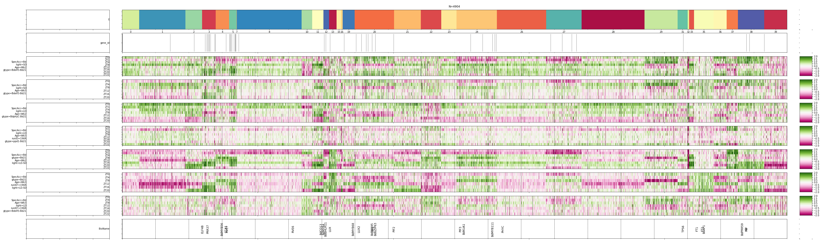
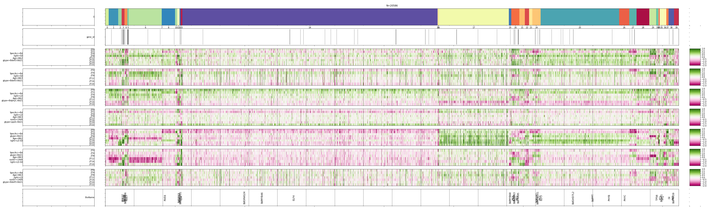
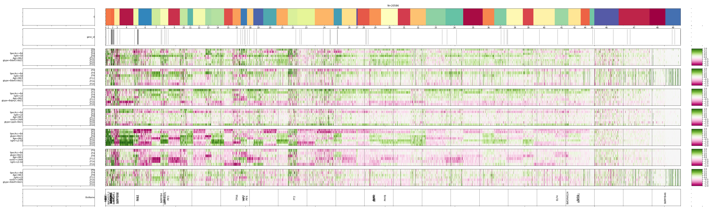
Use hyper-plane scoring in the latent-variable-model for unsupervised clustering

Slide 15
Use hyper-plane scoring in the latent-variable-model for unsupervised clustering
HyperPlane
Mixture
HyperPlane
Mixture
Gaussian
Mixture

Slide 16
Use hyper-plane scoring in the latent-variable-model for unsupervised clustering
Effect of elf3-1 at Wk2,SD
Effect of elf3-1 at Wk3,SD
Effect of phyC-KO at Wk2,SD
Effect of ppd1-1 at Wk3,SD
Effect of LD at Wk2
Effect of LD at Wk3

Slide 17
Summary:
- Hyperplane outperforms multivariate Gaussian in identifying co-regulated groups.
- It’s possibly to automatically define group of genes that share RNASeq signature and ChIP-Seq signature through an iterative/alternative scheme (similar to expectation maximisation).
- Each side of the algorithm itself can also be used alone to
- Leverage the server capacity for better organisation of reproducible plots and easier documentation of experiment info.
- Special thanks to Martin for trying out all these new techs!
- update on CAMTA:
http://172.26.114.34:81/static/figures/1119__peakBW__CAMTA__194C-4Cel__sigTarg/figure.html
http://172.26.114.34:81/static/figures/1122__rnaSeq__149R__chipTarg/figure.html
http://172.26.114.34:81/static/figures/1121__CAMTA__190R-191R__PCA/ISOMAP.html

